Slide 1
Robo-Science: Accident Challenge
Inspiration and some materials from:
slider.gatech.edu

Slide 2
Introductory Videos
Introduction to Challenge
Actual Collisions #1-3
Impact Info
Optional Additional Videos
Crash A
Crash B
Crash C
Notes:
Introductory Videos:
Intro to challenge: introduces the challenge
Collisions 1-3: students should make observations on the front side of “Collision Questions” handout
Strike Vehicle hits the Target Vehicle
If you do not use the handout:
Prompt the students to observe movement of both vehicles before, during, and after the collisions, then discuss.
Impact Info: students record observations on back side of “Collision Questions” handout
Strike Vehicle hits the Target Vehicle
If you do not use the handout:
Prompt students to observe movement of both vehicles before, during, and after the collisions, then discuss.
Discussion points:
What did you see/hear during the front impact collision?
What did you see/hear during the side impact collision?
What are some constraints faced by engineers when modeling collisions in a lab?
Optional videos: These videos show more car accidents involving vehicles of different sizes.
After viewing these videos, ask students how vehicle size affects damage in an accident.
Students can relate this information to large trucks hitting cars, as in the challenge.

Slide 3
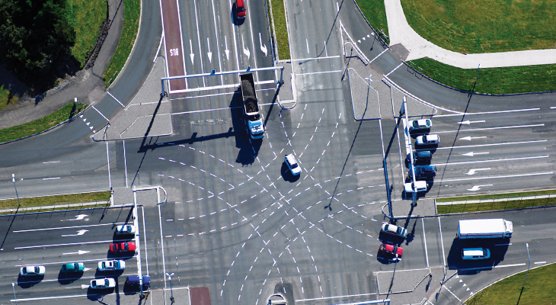
Traffic Engineering
YOU are assuming the role of a TRAFFIC ENGINEER
Video: Role of a Traffic Engineer
Image source:
http://www.gatewayengineers.com/services/traffic-engineering/
Notes:
Engineering: Using science and technology to design, build, or develop a solution to a problem

Slide 4
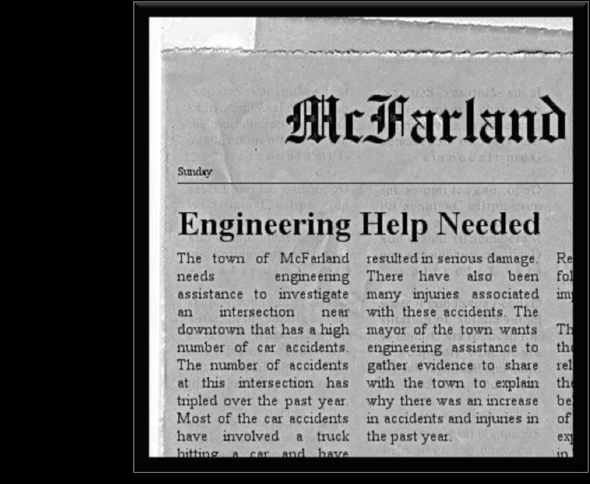
Notes:
Read article aloud to students as an initial introduction to the problem they will be working to solve.
Points to emphasize:
Accidents have increased drastically over the past year
Trucks are hitting cars
At this point, students should be given the “Organize the Challenge” handout. They can begin completing the “Things we know” section.

Slide 5
The Challenge: Why?
The people of the town of McFarland have an accident problem at the corner of Main Street and Park Street.
During the past year, this heavily used intersection near downtown has been the site of several dangerous accidents involving large tractor-trailer trucks hitting smaller cars.
Many of the accidents resulted in severe injuries and cars that had to be scrapped and totaled. That is, the cars could not be fixed and used again.
There have even been some fatalities as a result of these car accidents.
Notes:
This information is similar to the information in the article (key points)

Slide 6
The Challenge: What?
Your challenge is to assist the town of McFarland to understand why the accidents are causing more damage and injury.
You will determine the factors that lead to such accidents and explore possible solutions to the challenge.
Notes:
At this time, students are NOT ready to propose solutions, since they do not have enough information.
Students can jot down their ideas in the “Parking Lot” section of their “Organize the Challenge” handout, to revisit later
Students need to use the scientific process (observations, question, hypothesis, experiment, data analysis, conclusion) to develop their solution proposal.
Students should complete the “What we want to know” section of their organizer handout

Slide 7
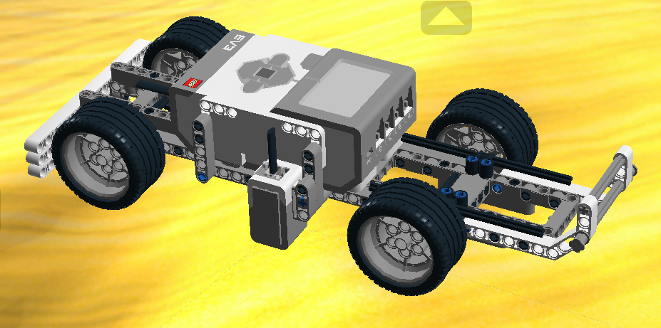
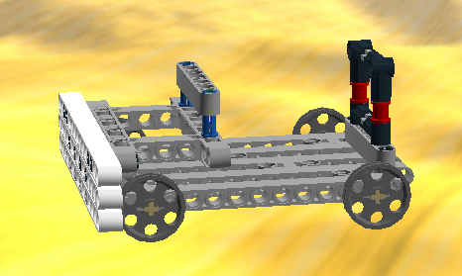
Create a Model
Use LEGO Digital Designer to build two models:
Truck Car
Use a bag of bb’s to weigh down the car:
Add bb’s until total mass = 250 g.
Notes:
It is suggested that student pairs team up with another pair for this experiment
One pair will build the truck, while the other will build the car.
Students will complete the project as a pair of two, they will just simulate the crashes with another pair to save space and time.
Notes about the car:
The car has been designed to hold a ziploc sandwich bag on top of it.
The bag will be filled with bb’s (or other small, heavy objects) to make its total mass 250 g.
Without this extra mass, the car will spin out when hit by the truck.
Students should place the car and bag on the scale together, then gradually add bb’s until 250 g is reached.
The bag can be secured by the beams connected by blue pegs in the car’s “trunk.”
Students should try to keep the bag centered on the car throughout the experiment to distribute weight evenly.
Students should also keep an eye on the bag’s position and make sure it does not get wedged between the car and a wheel.

Slide 8
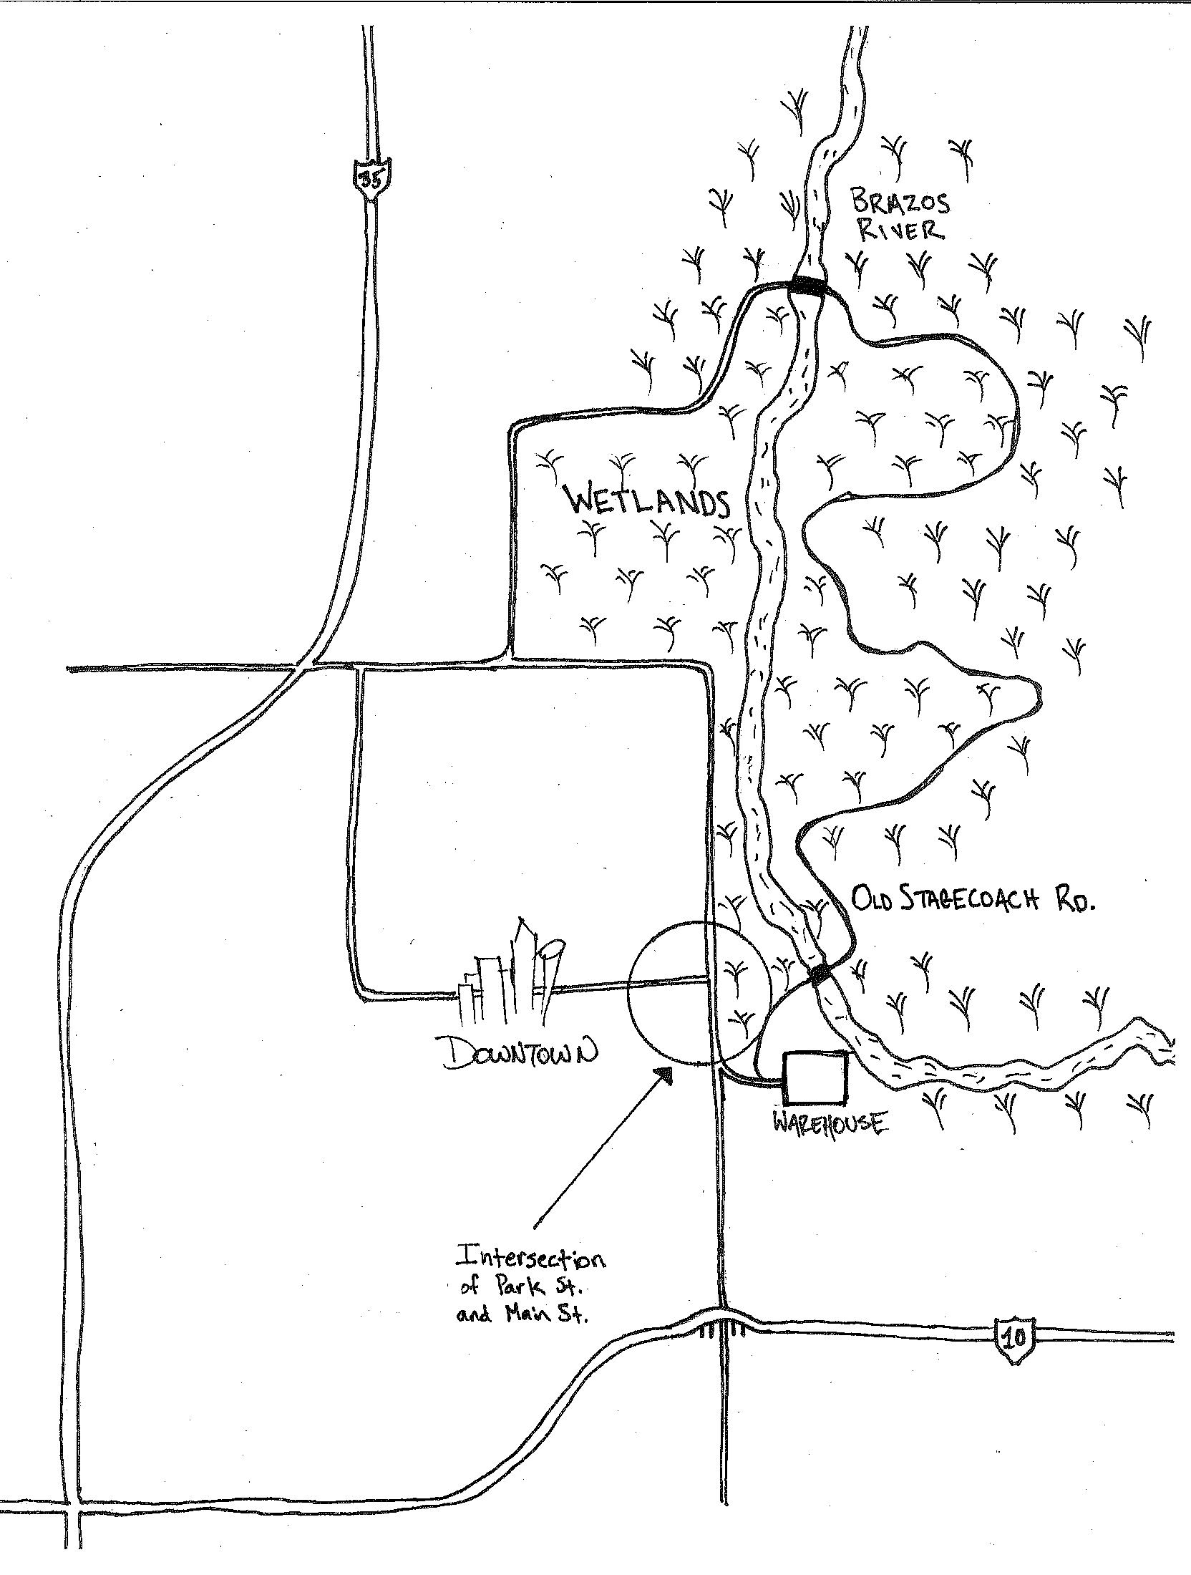
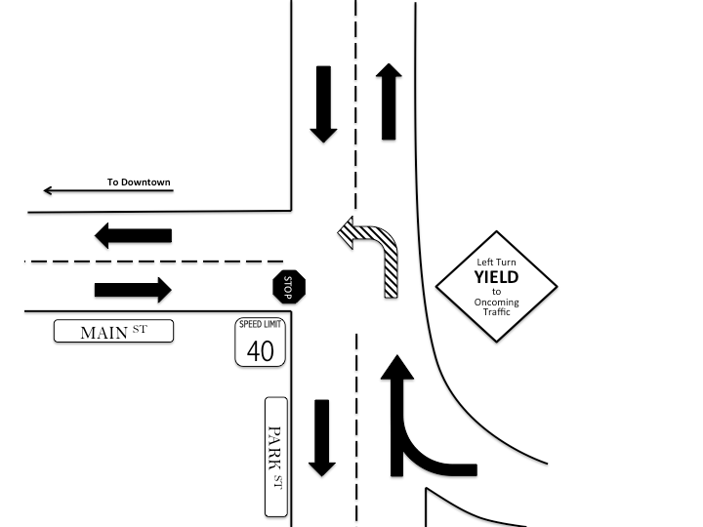
Background Information: Maps
Map 1: Town of McFarland
Map 2: Intersection Close-Up
Notes:
Students should record information from maps and videos in the “Facts/Observations” section of the organizer handout
They may also be able to add information to the “Constraints/Limitations” section
Map 1: City of McFarland
Wetlands are protected areas, cannot build in these areas
Three roads: Main St., Park St, Old Stagecoach Rd.
Old Stagecoach is the only alternate route
It is narrow, windy, long (slow speed limit)
Town bordered by two highways
Map 2: Intersection Close-Up
Left turn from Park to Main must yield
Through traffic does not stop
On-ramp feeds directly onto Park St.

Slide 9
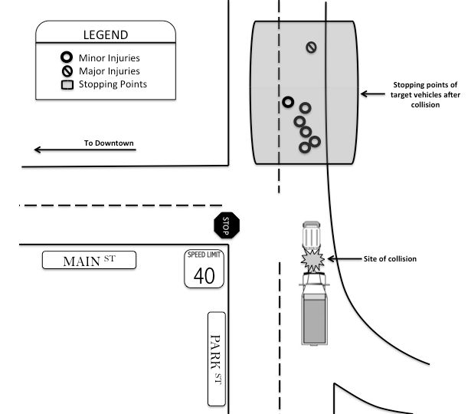
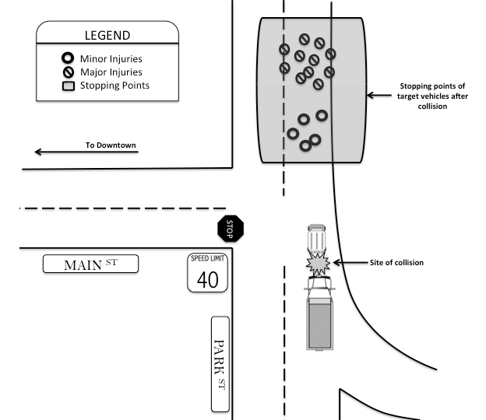
Background Information: Maps
Map 3: Previous Year’s Accident Data
Map 4: This Year’s Accident Data
Notes:
Map 3: Last year’s accident data
7 total accidents
Only one had major injuries
Map 4: This year’s accident data
18 total accidents
13 had major damage
Ask: How do the trends seen in the maps change from last year to this year?
More total accidents
More cars pushed farther
Greater distance pushed means more damage in accident

Slide 10
Background Information: Data
Notes:
Data discussion points:
Number of total accidents nearly tripled
Last year, majority of accidents were minor damage to vehicle, minor injuries
This year, majority of accidents were severe damage to vehicle, severe injuries
Two fatalities this year
Ask: Based on what you know, what may have caused these changes?

Slide 11
Background Information: Videos
Information from Mayor
Information from Police Chief
Notes:
Additional information to be recorded in “Facts/Observations” and “Constraints/Limitations” sections
Key points from Mayor:
Town is bordered by a river and farmland
Car factory has been an economic benefit to town
Distribution center opened South of town last year
Increased truck traffic as trucks leave loaded with parts
Car warehouse has on-ramp directly to highway
Trucks are hitting cars from behind
No light at intersection, left turn yields (stops) to wait but most trucks turn left
Key points from Police Chief:
Amount and severity of accidents have increased in past year
This year there were 2 fatalities
Collisions occurring when car is waiting to turn left and is hit from behind by a truck
This year, majority of car accidents are severe and further away from site of collision

Slide 12
Group Discussion
What are some things you know from prior experience?
What important facts and observations have you gathered from the challenge information and videos?
What are the constraints/limitations?
Notes:
Students should share responses to the questions above based on information they recorded in their organizer

Slide 13
Brainstorm
What existing scientific knowledge will you need to use during this challenge?
Working within the constraints of budget and time, what are some possible solutions to McFarland’s problem?
Notes:
Existing scientific knowledge needed (examples):
Speed, velocity, and acceleration
Momentum
Newton’s Laws of Physics
1st Law: Law of inertia
2nd Law: F = ma
3rd Law: Action-reaction force pairs
Kinetic and potential energy
Law of Conservation of Energy
Work
Force
Friction
Possible solutions:
Students will have many ideas – using limitations of BUDGET (very low) and TIME (very little), help them narrow down suggestions.
Guide conversation to the ideas of limiting WEIGHT (mass) and/or SPEED.
Do not allow students to propose solution YET – just narrow down where they are going to focus efforts.
Additional research is needed to determine values for speed and/or mass limits, they cannot be obscure.

Slide 14
Simulating McFarland
Now, as traffic engineers, you must create a model to study the collisions under different conditions.
You will propose a solution based on your data and observations.
Notes:
Choose one:
Expanded Version:
If you want to test 3 speeds and 3 masses, use slides 15-23 (blue background)
Abridged Version:
If you want to test 2 speeds and 2 masses, use slides 24-32 (orange background)

Slide 15
Build Model Intersection
Set up a model on-ramp as follows:
Use 8x4 whiteboards
Place 4 kits behind the board - 2 stacks of 2*
Place a thick line of tape to mark where the incline ends (“ramp”) and the board becomes flat (“road”)
Moving away from “ramp”, measure 45 cm from taped line and place another parallel line of tape
*Get highest angle so that front truck bumper or light sensor does not touch board when transitioning from “ramp” to “road”
Notes:
In this setup, all ramps will be set up the same. Two groups can share each ramp (one group on either side).
Students should measure the height of their ramp at the highest point. They should check their ramps before each trial to ensure that this height remains consistent throughout the experiment, because if the height changes, that means that the ramp angle has also changed. If the height changes, they need to adjust the board to return to the starting height.

Slide 16
Preliminary Questions
You have determined that the city should regulate truck speed and/or truck mass.
How can we model different truck speeds?
How can we model different truck masses?
How can we test both variables (speed and mass) and still have a valid experiment?
What is the dependent/responding variable?
What variables should be controlled?
Notes:
Students should share their responses to the questions. Discussion points are below.
How can we model different truck speeds?
Because of gravity and acceleration, the truck will gain speed as it comes down the ramp. The longer it is on the ramp, the more time it will be able to accelerate, and thus, the faster its speed.
Because of potential energy, the truck will have more energy if it starts from a higher position on the ramp.
The law of conservation of energy states that energy cannot be created or destroyed, only transformed.
Potential energy is converted to kinetic energy, and thus, a truck with constant mass that has a greater height (more potential energy) at the top of the ramp will have a greater speed (more kinetic energy) at the bottom of the ramp
How can we model different truck masses?
We can add mass to the bed of the truck to weigh it down
You do NOT need to change the design of the truck, it is designed to hold extra load in its bed
How can we test both variables (speed and mass) and still have a valid experiment?
Students will actually be conducting two experiments at once
The experiment is valid because they will test all possible combinations of speed and mass, which is like doing two experiments
Test same mass at high, mid, low speed
Test same speed with high, mid, low mass
What is the dependent/responding variable?
Distance that the car travels after being hit by the truck
Remember, greater distance means greater damage
What variables should be controlled?
All variables besides truck mass, release height, and distance car travels after impact should be controlled. This includes, but is not limited to:
Ramp angle
Truck release technique
Mass of car
Starting point of measurement for car distance

Slide 17
Procedure Questions
You now need to collect information so that you can propose HOW the city should regulate truck speed and/or truck mass.
You will need to test collisions that occur at low, mid, and high speed, and with truck mass of 500g, 750g, and 1000g. How many combinations will you need to test?
What will happen to the truck's momentum as mass is increased? As speed is increased?
Notes:
Emphasize the importance of using data to come up with a solution to the problem
Students will need to test 9 combinations (3 speeds x 3 masses = 9 total combinations)
Momentum is a product of mass and velocity. P = mv
When the truck’s mass increases, the truck’s momentum should also increase
When the truck’s speed increases, the truck’s momentum should also increase
Students will determine whether mass and speed affect distance the car is pushed, or if mass OR speed has a greater effect.
They will use this information to propose a mass limit, speed limit, or both.

Slide 18
Variables: Speed and Mass
Speed
Measure 3 truck lengths from top of ramp and mark each length with dry erase marker.
Each length represents a starting position: high, mid, or low, which correlates to a speed.
Mass
500 g: Empty truck mass
750 g: Place one 200g and one 50g weight in truck bed
1000 g: Place two 200g weights in truck bed. Hang two 50g weights on the back of the truck bed.
Notes:
Students should mark from the front of the truck’s bumper to indicate one truck length. Then, they can just line up the bumper with the line they drew for each trial at that release height.
Use mass kits, or other small objects with fixed mass, to load the truck. The car’s mass remains constant.

Slide 19
Data and Observations
For each trial, you will record the speed* of the truck and distance the car travels under different conditions of truck mass and truck speed.
*Speed should correlate with ramp height, so there should be very little variation for speeds at the same height.
You and your partner will be given a data table.
If space in room is an issue: Partner up with another pair to collect data - you will use ONE truck and ONE car, but you will each record the data separately.
Once you have your data table, you can begin collecting data.
Notes:
Students will need to run program “Accident Challenge” for this experiment
This program will calculate and display the truck’s speed on the brick
The car will say “start” and “stop” to acknowledge when it crosses the tape lines
Students must listen carefully to make sure both are said at the appropriate times
If they are not said at appropriate times, then that trial is invalid and should be repeated
The speed should remain fairly constant for any trials conducted from the same height, regardless of truck mass
Use “Simulation Data_Expanded” data table handout to collect data for truck speed and car distance
Students will do three trials each for all nine mass/speed combinations
Car distance should be measured in cm

Slide 20
Data Analysis: Scale Factor
The high speed you tested represented 40 mph (the speed limit). However, this was not the actual high speed in the simulation.
What scale factor is needed to scale up your fastest simulation speed to 40 mph?
Scale factor is the number you will multiply your simulation speed by to convert it to 40mph.
Use this scale factor to convert all of your average speeds from the simulation into mph.
Notes:
To calculate scale factor, use the following ratio:
40 mph / (highest simulation speed) m/s = X mph / 1 m/s
Solve for X
Students will multiply their simulation speeds (in m/s) by X to convert them to a real-life speed in mph

Slide 21
Data Analysis: Graphs
Using your collected data, make the following graphs (3 graphs total):
Make a bar graph to compare distance the car traveled for each combination of truck speed and mass. You will have 9 bars total.
Locate your tallest bar. Find the ramp height (speed) and mass combination that led to that tallest bar. These will be your target speed and target mass. You will use these to determine which has a greater effect on the distance the car is pushed - speed or mass.
For target speed, make a scatterplot of mass vs. distance. You will have 3 points in your scatterplot (target ramp height with 500, 750, 1000 g).
For target mass, make a scatterplot of speed vs. distance. You will have 3 points in your scatterplot (target mass at low, mid, high height - use speed)
Notes:
Students can use graphing programs (Google Sheets, Microsoft Excel, etc.) or make graphs by hand
For bar graph:
Calculate and graph the average car distance for each truck condition (speed/mass combo)
Manipulated variable (x-axis) is truck conditions (mass/speed combo) – there will be nine conditions
Responding variable (y-axis) is car distance
After bar graph is made, students identify the tallest bar, representing the distance of the car that was pushed the farthest
Note the speed and mass combo that lead to this tallest bar
(teacher hint: the tallest bar should be one of the high speed conditions, but may not be the heaviest load)
The speed (release height) that resulted in tallest bar is “target speed”
The mass that resulted in the tallest bar is “target mass”
Target Speed:
Create a scatterplot (x-y graph) that compares mass vs. distance for that speed only (all three masses when truck released at chosen height)
There will be THREE points on the graph
Mass is manipulated variable (x-axis)
Car distance is dependent variable (y-axis)
Target Mass:
Create a scatterplot (x-y graph) that compares speed vs. distance for that mass only (all three speeds/release height for the truck with chosen mass)
There will be THREE points on the graph
Mass is manipulated variable (x-axis)
Car distance is dependent variable (y-axis)
(Teacher hint): The scatterplots should show a trend (direct relationship) for speed vs. distance, but NO trend should be seen for mass vs. distance
A.K.A. Students should see that increasing truck speed increases the car distance, but truck mass has no effect on car distance

Slide 22
Further Analysis
Label each bar on your bar graph as "minor damage", "major damage", or "fatal damage". Explain how you distinguished between the level of damage.
Which bar represents the conditions that will most likely lead to fatal accidents? Why?
Which has the greater impact on distance - truck speed or truck mass?
Notes:
Students should determine bar height levels that indicate severity of damage
There should be few fatal accidents (1-2 maximum)
The remaining accidents should be classified as major or minor damage
The tallest bar (should be one of the high speed trucks, mass may vary) represents the conditions that will most likely lead to fatal accidents
Truck speed has a greater impact on car distance than truck mass
This is because of the Law of Conservation of Energy and Kinetic Energy
Trucks with higher speed (higher release height) have more energy
This energy is transferred to the car
Speed has a greater impact because KE = ½ m v², so increases to velocity (speed) will lead to a greater increase in energy than any changes made to mass, since velocity is squared when calculating kinetic energy

Slide 23
Conclusion
Propose a speed limit and/or weight limit to the mayor of McFarland. You must support your proposal with data collected during the experiment.
Notes:
(Teacher hint): Students should propose a SPEED LIMIT, but not a mass limit
Data must be used to support proposal (there must be scientific reasoning for solution proposed)
Students should use the converted speed (in mph) that they calculated previously to propose their speed limits
The proposed solution should maximize efficiency while increasing safety
For example, students should propose a speed limit that is the highest speed that only leads to minor accidents.
Students should not make any proposals that they cannot defend with their data.

Slide 24
Build Model Intersection
Set up a model on-ramp as follows:
Use 8x4 whiteboards
Two ramp setups:
Low: Place 2 kits behind the board – 2 stacks of 1*
High: Place 4 kits behind the board - 2 stacks of 2*
Place a thick line of tape to mark where the incline ends (“ramp”) and the board becomes flat (“road”)
Moving away from “ramp”, measure 45 cm from taped line and place another parallel line of tape
*Get highest angle so that front truck bumper or light sensor does not touch board when transitioning from “ramp” to “road”
Notes:
In this setup, there will be two ramp heights: low and high. Groups will use both ramps to manipulate the speed of their truck.
Students should measure the height of each ramp at the highest point. They should check the ramps before each trial to ensure that this height remains consistent throughout the experiment, because if the height changes, that means that the ramp angle has also changed. If the height changes, they need to adjust the board to return to the starting height.

Slide 25
Preliminary Questions
You have determined that the city should regulate truck speed and/or truck mass.
How can we model different truck speeds?
How can we model different truck masses?
How can we test both variables (speed and mass) and still have a valid experiment?
What is the dependent/responding variable?
What variables should be controlled?
Notes:
Students should share their responses to the questions. Discussion points are below.
How can we model different truck speeds?
Because of gravity and acceleration, the truck will gain speed as it comes down the ramp. The longer it is on the ramp, the more time it will be able to accelerate, and thus, the faster its speed.
Because of potential energy, the truck will have more energy if it starts from a higher position on the ramp.
The law of conservation of energy states that energy cannot be created or destroyed, only transformed.
Potential energy is converted to kinetic energy, and thus, a truck with constant mass that has a greater height (more potential energy) at the top of the ramp will have a greater speed (more kinetic energy) at the bottom of the ramp
How can we model different truck masses?
We can add mass to the bed of the truck to weigh it down
You do NOT need to change the design of the truck, it is designed to hold extra load in its bed
How can we test both variables (speed and mass) and still have a valid experiment?
Students will actually be conducting two experiments at once
The experiment is valid because they will test all possible combinations of speed and mass, which is like doing two experiments
Test same mass at high and low speed
Test same speed with high and low mass (full and empty truck)
What is the dependent/responding variable?
Distance that the car travels after being hit by the truck
Remember, greater distance means greater damage
What variables should be controlled?
All variables besides truck mass, release height, and distance car travels after impact should be controlled. This includes, but is not limited to:
Ramp angle
Truck release technique
Mass of car
Starting point of measurement for car distance

Slide 26
Procedure Questions
You now need to collect information so that you can propose HOW the city should regulate truck speed and/or truck mass.
You will need to test collisions that occur at low and high speed, and with an empty and full truck. How many combinations will you need to test?
What will happen to the truck's momentum as mass is increased? As speed is increased?
Notes:
Emphasize the importance of using data to come up with a solution to the problem
Students will need to test 4 combinations (2 speeds x 2 masses = 4 total combinations)
Momentum is a product of mass and velocity. P = mv
When the truck’s mass increases, the truck’s momentum should also increase
When the truck’s speed increases, the truck’s momentum should also increase
Students will determine whether mass and speed affect distance the car is pushed, or if mass OR speed has a greater effect.
They will use this information to propose a mass limit, speed limit, or both.

Slide 27
Variables: Speed and Mass
Speed
Measure one truck length from top of each ramp and mark the length with dry erase marker.
The high ramp represents high speed, and the low ramp represents low speed
Mass
Empty truck mass: 500g
Full truck mass: Add mass to bed of truck to increase truck mass to 1000g
Notes:
Students should mark from the front of the truck’s bumper to indicate one truck length. Then, they can just line up the bumper with the line they drew for each trial at that release height.
Use mass kits, or other small objects with fixed mass, to load the truck. The car’s mass remains constant.

Slide 28
Data and Observations
For each trial, you will record the speed* of the truck and distance the car travels under different conditions of truck mass and truck speed.
*Speed should correlate with ramp height, so there should be very little variation for speeds on the same ramp.
You and your partner will be given a data table.
If space in room is an issue: Partner up with another pair to collect data - you will use ONE truck and ONE car, but you will each record the data separately.
Once you have your data table, you can begin collecting data.
Notes:
Students will need to run program “Accident Challenge” for this experiment
This program will calculate and display the truck’s speed on the brick
The car will say “start” and “stop” to acknowledge when it crosses the tape lines
Students must listen carefully to make sure both are said at the appropriate times
If they are not said at appropriate times, then that trial is invalid and should be repeated
The speed should remain fairly constant for any trials conducted from the same height, regardless of truck mass
Use “Simulation Data_Abridged” data table handout to collect data for truck speed and car distance
Students will do three trials each for all four mass/speed combinations
Car distance should be measured in cm

Slide 29
Data Analysis: Scale Factor
The high speed you tested represented 40 mph (the speed limit). However, this was not the actual high speed in the simulation.
What scale factor is needed to scale up your fastest simulation speed to 40 mph?
Scale factor is the number you will multiply your simulation speed by to convert it to 40mph.
Use this same scale factor to convert your average low speed from the simulation into mph.
Notes:
To calculate scale factor, use the following ratio:
40 mph / (highest simulation speed) m/s = X mph / 1 m/s
Solve for X
Students will multiply their simulation speeds (in m/s) by X to convert them to a real-life speed in mph

Slide 30
Data Analysis: Graphing
Using your collected data, make a bar graph to compare distance the car traveled for each combination of truck speed and mass. You will have 4 bars total.
Locate your tallest bar. Find the ramp height (speed) and mass combination that led to that tallest bar. These will be your target speed and target mass. You will use these to determine which has a greater effect on the distance the car is pushed - speed or mass.
For target speed, compare how increasing the mass affected the distance the car traveled.
For target mass, compare how increasing the speed affected the distance the car traveled.
Notes:
Students can use graphing programs (Google Sheets, Microsoft Excel, etc.) or make graphs by hand
For bar graph:
Calculate and graph the average car distance for each truck condition (speed/mass combo)
Manipulated variable (x-axis) is truck conditions (mass/speed combo) – there will be four conditions
Responding variable (y-axis) is car distance
After bar graph is made, students identify the tallest bar, representing the distance of the car that was pushed the farthest
Note the speed and mass combo that lead to this tallest bar
(teacher hint: the tallest bar should be one of the high speed conditions, but may not be the full truck)
The speed (low or high) that resulted in tallest bar is “target speed”
The mass (empty or full) that resulted in the tallest bar is “target mass”
Target Speed:
Compare mass vs. distance for that speed only
How does increasing the mass affect the distance the car travels at this speed?
Target Mass:
Compare speed vs. distance for that mass only
How does increasing the speed affect the distance the car travels at this mass?
(Teacher hint): Students should observe a trend (direct relationship) for speed vs. distance, but NO trend should be seen for mass vs. distance
A.K.A. Students should see that increasing truck speed increases the car distance, but truck mass has no effect on car distance

Slide 31
Further Analysis
Label each bar on your bar graph as "minor damage", "major damage", or "fatal damage". Explain how you distinguished between the level of damage.
Which bar represents the conditions that will most likely lead to fatal accidents? Why?
Which has the greater impact on distance - truck speed or truck mass?
Notes:
Students should determine bar height levels that indicate severity of damage
There should be few fatal accidents (maybe 1)
The remaining accidents should be classified as major or minor damage
The tallest bar (should be one of the high speed trucks, mass may vary) represents the conditions that will most likely lead to fatal accidents
Truck speed has a greater impact on car distance than truck mass
This is because of the Law of Conservation of Energy and Kinetic Energy
Trucks with higher speed (higher release height) have more energy
This energy is transferred to the car
Speed has a greater impact because KE = ½ m v², so increases to velocity (speed) will lead to a greater increase in energy than any changes made to mass, since velocity is squared when calculating kinetic energy

Slide 32
Conclusion
Propose a speed limit and/or weight limit to the mayor of McFarland. You must support your proposal with data collected during the experiment.
Notes:
(Teacher hint): Students should propose a SPEED LIMIT, but not a mass limit
Data must be used to support proposal (there must be scientific reasoning for solution proposed)
Students should use the converted speed (in mph) that they calculated previously to propose their speed limits
The proposed solution should maximize efficiency while increasing safety
For example, students should propose a speed limit that is the highest speed that only leads to minor accidents.
Students should not make any proposals that they cannot defend with their data.

